Slide 1
Discrete Mathematics and Logic (UE18CS205)
Unit 1 - Logic
Mr. Channa Bankapur (channabankapur@pes.edu)
Department of CS&E, PES University

Slide 2
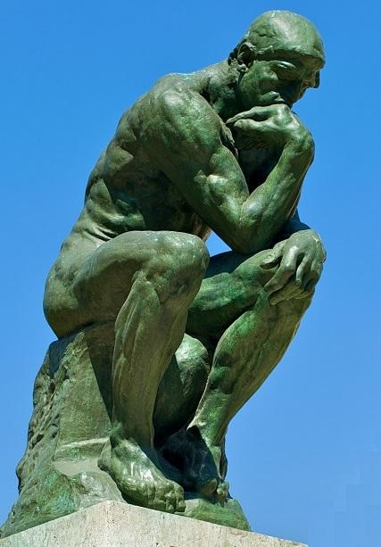
What is Logic? “Le Penseur”
Sir, “I love you”
and “You love your daughter”
Therefore, it implies that
“I love your daughter”
“All IITians are talented”
“Arvind is an IITian”
Therefore, “Arvind is talented”
“If one is crazy, one drills teeth”
“My dentist drills teeth”
Therefore, “My dentist is crazy”

Slide 3
Does this argument makes sense?
“If Superman exists, then he is neither powerless nor evil-minded”
“If Superman were able and willing to prevent evil, then he would prevent evil”
“If Superman were unable to prevent evil, then he would be powerless”
“If Superman were unwilling to prevent evil, then he would be evil-minded”
“Superman does not prevent evil”
Therefore, “Superman does not exists”.

Slide 4
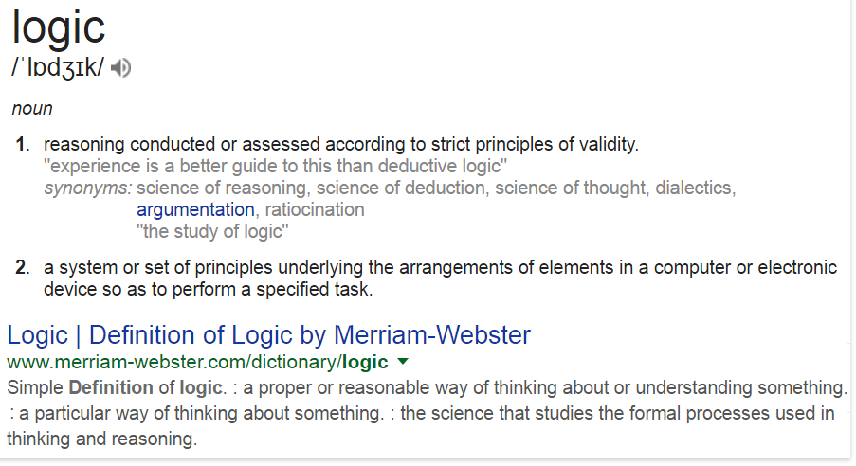
What is Logic?

Slide 5
What is Logic?
Logic: Science dealing with principles of valid arguments and reasoning. Logic is rooted in basic cause and effect.
Common Sense: Ability to see the world in a way which is common to most people.
Fallacies!
A failure in reasoning which renders an argument invalid.

Slide 6
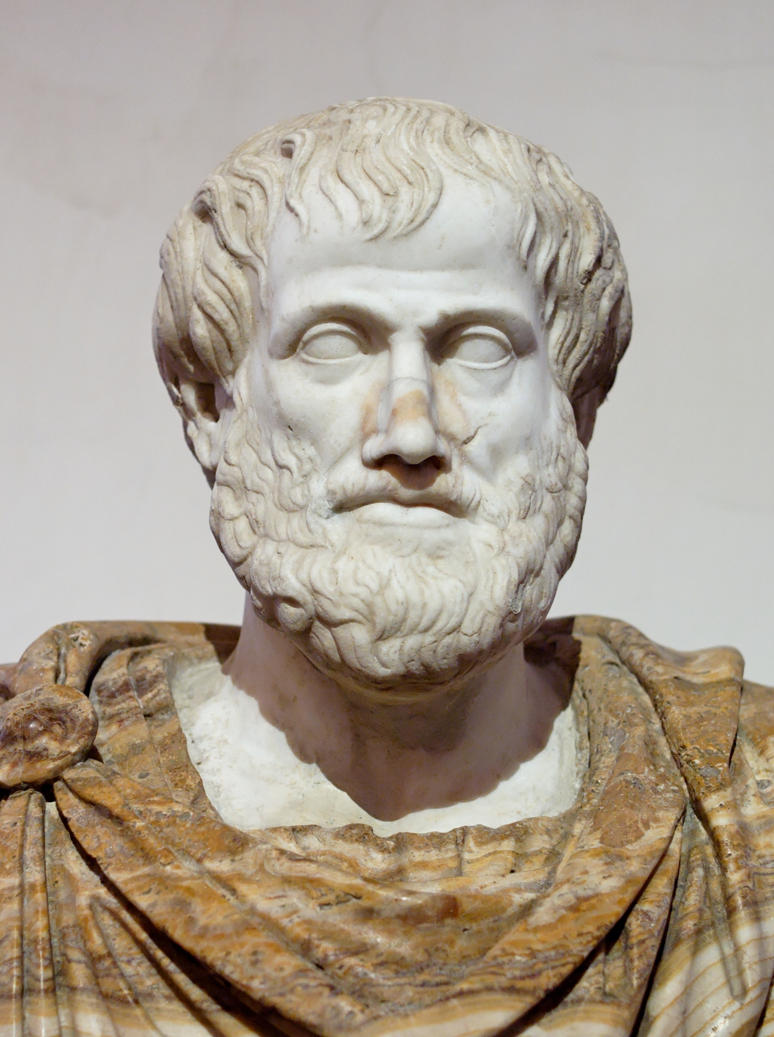
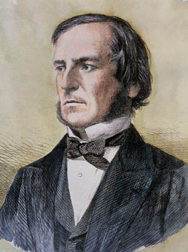
Aristotle 384-322BC: Organon collection
George Boole (1815-64): The Laws of Thought
Proposition: A proposition is a declarative sentence that is either true or false, but not both.
Propositional Logic (Propositional Calculus): The area of logic that deals with propositions.

Slide 7
Proposition or not?
Bangalore is the capital city of India.
New Delhi is the capital city of India.
Do you like coffee?
Get me a cup of coffee.
1 + 2 = 3
2 + 3 = 4
x + 3 = 10
Mahatma Gandhi was born in the year 1869.
It’s raining today.
Earth is flat.

Slide 8
Propositions:
New Delhi is the capital city of India. // true
Bangalore is the capital city of India. // false
1 + 2 = 3 // true
2 + 3 = 4 // false
Mahatma Gandhi was born in 1869. // true
It’s raining today. // false
Earth is flat. // false

Slide 9
These are NOT propositions:
Get me a cup of coffee.//not a declarative sentence
Do you like coffee?//not a declarative sentence
Though the response to the question could be yes or no; a binary response.
x + 1 = 2 // has a variable
It’s a declarative sentence, but depending on the value of ‘x’, it can be true or false.
It can be turned into a proposition by giving a value for ‘x’.
x + y = z. // has variables

Slide 10
Compound Propositions: are propositions formed from existing propositions using logical operators.
Logical Operators:
Negation (￢)
Conjunction (∧)
Disjunction (∨)
Exclusive OR (⊕)
Conditional Statement (→)
Biconditional Statement (↔)

Slide 11
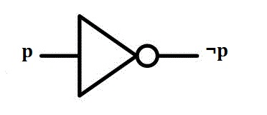
Negation: Let p be a proposition. The negation of p, denoted by ￢p, is the statement “It is not the case that p”. The proposition ￢p is read “not p”. The truth value of the negation of p is the opposite of the truth value of p.
Eg: Let p be “Today is Friday”
￢p: “It’s not the case that today is Friday”
Truth table of Negation:
￢p: “Today is not Friday”
p | ￢p
F | T
T | F

Slide 12
What’s the negation of the following propositions?
“Bengaluru is the capital city of India”
“Indian Cricket team won at least three matches in the series”
“Number 5 turned up when the dice is rolled”
￢p
“I don’t love you”

Slide 13
Examples:
“Not knowing traffic rules is not an excuse for not following them”.
“Not attending the class is not an excuse for not completing the assignment”.

Slide 14
A scene from The Big Bang Theory (sitcom)..
Sheldon: “I would not object to us no longer characterizing you as not my girlfriend”
Amy: Interesting! Now try without quadruple negation.
Sheldon: I am fine with you being my girlfriend.

Slide 15
Sheldon of The Big Bang Theory (sitcom) says..
“I would not object to us no longer characterizing you as not my girlfriend”
→ I am fine with us no longer characterizing you as not my girlfriend.
→ I am fine with you being my girlfriend.

Slide 16
Careful while cancelling out double negations:
“I do not disagree” is not same as
“I agree”.
“A nonnegative number” is not same as
“A positive number”.
“Not a nonnegative number”
is …

Slide 17
Incorrect usage of double negation:
The IT Crowd (sitcom) …
Roy: ♮ We don’t need no education ♮
Moss: “Yes you do. You’ve just used a double negation.”

Slide 18
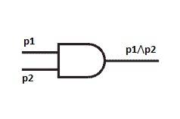
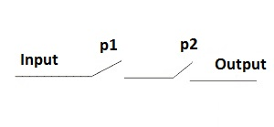
Conjunction: Let p and q be propositions. The conjunction of p and q, denoted by p∧q, is the proposition “p and q”. The conjunction p∧q is true when both p and q are true and is false otherwise.
p | q | p∧q
F | F | F
F | T | F
T | F | F
T | T | T

Slide 19
Examples for Conjunction:
p∧q: “He brought pen and notebook to the class”
p: “He brought pen to the class”
q: “He brought notebook to the class”
If he brings just pen, but not notebook, he is not standing by the statement.
p∧q: “Tea and Coffee are served in the conference”
p: “Tea is served in the conference”
q: “Coffee is served in the conference”
“Don’t drink and drive”

Slide 20
Don’t drink and drive.
drinK | driVe | ￢K ∧ V | ￢(K ∧ V)
F | F | F | T
F | T | T | T
T | F | F | T
T | T | F | F

Slide 21
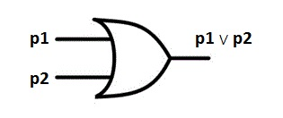
Disjunction: Let p and q be propositions. The disjunction of p and q, denoted by p∨q, is the proposition “p or q”. The disjunction p∨q is false when both p and q are false and is true otherwise.
p | q | p∨q
F | F | F
F | T | T
T | F | T
T | T | T

Slide 22
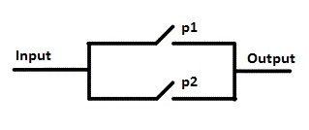
Disjunction: Let p and q be propositions. The disjunction of p and q, denoted by p∨q, is the proposition “p or q”. The disjunction p∨q is false when both p and q are false and is true otherwise.
p | q | p∨q
F | F | F
F | T | T
T | F | T
T | T | T

Slide 23
Examples for Disjunction:
p∨q: “He has an apple or an orange”
p: “He has an apple”
q: “He has an orange”
Note: Having both an apple and an orange is okay too.
Condition to play the roller-coaster:
p∨q: “you are tall or you are an adult”
p: “You are tall”
q: “You are an adult”
That is, only short kids are not allowed.

Slide 24
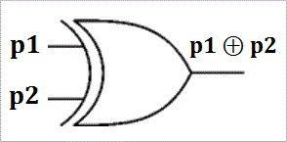
Exclusive OR: Let p and q be propositions. The “exclusive or” of p and q, denoted by p⊕q, is the proposition “either p or q, but not both”. The “exclusive or” p⊕q is true when exactly one of p and q is true and is false otherwise.
p | q | p⊕q
F | F | F
F | T | T
T | F | T
T | T | F

Slide 25
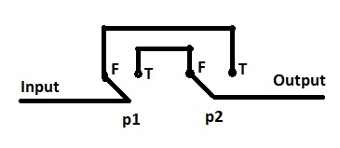
Exclusive OR: Let p and q be propositions. The “exclusive or” of p and q, denoted by p⊕q, is the proposition “either p or q, but not both”. The “exclusive or” p⊕q is true when exactly one of p and q is true and is false otherwise.
p | q | p⊕q
F | F | F
F | T | T
T | F | T
T | T | F

Slide 26
Examples for Exclusive OR:
p⊕q: “Last night he was in Chennai or Mumbai”
p: “Last night he was in Chennai”
q: “Last night he was in Mumbai”
Note: Obviously you are not expecting the case of he being in both Mumbai and Chennai.
p⊕q: “Dharmendra likes to marry Seeta or Geeta”
Note: If he likes to marry both, the statement would be false. It’s false even when he doesn’t like to marry either.
p⊕q: “Do or die”

Slide 27
Inclusive OR or Exclusive OR ?
“Experience with C++ or Java is required.”
“Coffee or tea comes with dinner.”
“Prerequisite for the course is a course in Discrete Math or Digital Logic.”
“For identification, you need to bring your passport or voter id card.”
“In the Identification field, mention your passport number or voter id number”

Slide 28
 |  | Negation | Conjunction | Disjunction | Exclusive OR
p | q | ￢p | p∧q | p∨q | p⊕q
F | F | T | F | F | F
F | T | T | F | T | T
T | F | F | F | T | T
T | T | F | T | T | F

Slide 29
Conditional Statement: Let p and q be propositions. The “conditional statement” p→q is false when p is true and q is false, and true otherwise. Conditional statements are also called implications.
Truth table of Conditional Statement:
In p→q,
p is called hypothesis,
premise
or antecedent
q is called conclusion
or consequence
p | q | p→q
F | F | T
F | T | T
T | F | F
T | T | T

Slide 30
Note: A useful way to understand the truth value of a conditional statement is to think of it as an obligation or a contract.
Eg: A pledge made by a politician running for an office, “If I am elected, then I will lower the taxes”.
“If I am elected” | “I will lower the taxes” | “I am elected” → “I will lower the taxes”
F | F | T (Pledge is intact. Can’t expect to lower taxes when the politician is not elected.)
F | T | T (Pledge is intact. The politician might have used his influence to lower the taxes even though he is not elected.)
T | F | F (Pledge is broken.)
T | T | T (Pledge is intact. Taxes are lowered.)

Slide 31
“If you top the class, then you will find a job”.
“If you are good at problem solving, then you will find a job”.
“If you top the class, then you will get an award”.
Let top be “You top the class”,
job: “You will find a job”,
good: “You are good at problem solving”,
award: “You will get an award”.
good
↘
top → job
↘
award

Slide 32
The following forms are equivalent to p→q.
p implies q
if p, then q
if p, q
q if p
q when p
q whenever p
q follows from p
p only if q
q unless ￢p
p is sufficient for q
a sufficient condition for q is p
q is necessary for p
a necessary condition for p is q

Slide 33
Converse, Inverse and Contrapositive
of a Conditional Statement
Conditional Statement p → q | Converse q → p
Inverse ￢p → ￢q | Contrapositive ￢q → ￢p
p | q | p → q | q → p | ￢p → ￢q | ￢q → ￢p
F | F | T | T | T | T
F | T | T | F | F | T
T | F | F | T | T | F
T | T | T | T | T | T

Slide 34
Eg: Let p: “You top the class” and
q: “You will find a job”.
Conditional statement p → q
“If you top the class, then you will find a job”.
Contrapositive ￢q→￢p
“If you did not find a job, then you did not top the class”.
Inverse ￢p→￢q
“If you do not top the class, then you will not find a job”.
Converse q → p
“If you found a job, then you must’ve topped the class”.

Slide 35
Biconditional Statement: Let p and q be propositions. The biconditional statement p↔q is the proposition “p if and only if q”. The biconditional statement p↔q is true when p and q have the same truth values, and is false otherwise.
Biconditional statements are also called as bi-implications.
p | q | p↔q
F | F | T
F | T | F
T | F | F
T | T | T

Slide 36
p if and only if q
(p if q) and (p only if q)
(q → p) ∧ (p → q) ≡ (p ↔ q)
Are converse of the following statements are also true?
“If two integers are odd then their product is odd”
“If two integers are even then their product is even”
Eg:
p→q: “if the switch is on, then the current flows”.
p↔q: “current flows if and only if the switch is on”.

Slide 37
p | q | p → q | q → p | (p→q)∧(q→p) | p↔q
F | F | T | T | T | T
F | T | T | F | F | F
T | F | F | T | F | F
T | T | T | T | T | T
∴ p↔q is equivalent to (p→q)∧(q→p)

Slide 38
Eg: Let p: “I have time” and
q: “I will go to movie”
p→q: “If I have time, then I will go to movie”
(or “I will go to movie if I have time”)
It’s a promise you make to your friend.
q→p: “I will go to movie only if I have time”
It’s a promise you make to your dad.
p↔q: “I will go to movie if and only if I have time”

Slide 39
Eg: “You can access the C lab only if you are a computer science major or you are a freshman”.
Let a be “you can access the C lab”,
c be “you are a computer science major”, and
f be “you are a freshman”.
a → (c ∨ f) is required expression.
It doesn’t mean “if you are a computer science major or you are a freshman then you’ll always get access to the C lab”.

Slide 40
Conditional Love!
“He loves her if she loves him”
“He loves her only if she loves him”
“He loves her if and only if she loves him”
“He loves her whether she loves him or not”

Slide 41
Conditional Love!
Let he: “He loves her”, she: “She loves him”
she → he: “He loves her if she loves him”
he → she: “He loves her only if she loves him”
she ↔ he: “He loves her if and only if she loves him”
(she∨￢she)→he: “He loves her whether she loves him or not”
he | she | she→he | he→she | she↔he | (she ∨ ￢she)→he
F | F | T | T | T | F
F | T | F | T | F | F
T | F | T | F | F | T
T | T | T | T | T | T

Slide 42
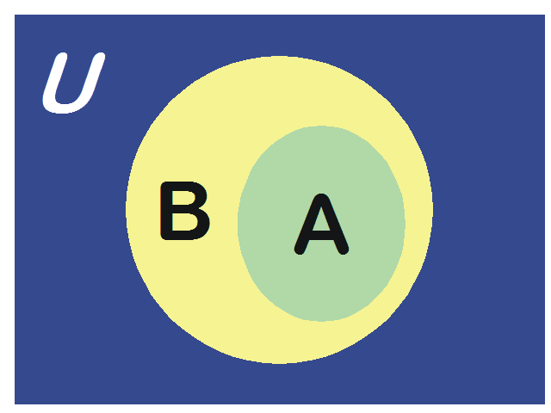
“It is sufficient to wash your boss’s car to get promoted”
i.e., Washing boss’s car → Getting promotion
“It is necessary to wash your boss’s car to get promoted”
i.e., Got promoted → Washed boss’s car
“It is necessary and sufficient to wash your boss’s car to get promoted”
Got promoted ↔ Washed boss’s car

Slide 43
“You cannot ride the roller coaster if you are under 4 feet tall unless you are at least 16 years old”.
noride: “you cannot ride the roller coaster”
short: “you are under 4 feet tall” (you are short)
adult: “you are at least 16 years old” (you are an adult)
“noride if short unless adult”.
“You cannot ride the roller coaster if you are short unless you are an adult”.

Slide 44
“noride if short unless adult”.
short→noride: “You cannot ride if you are short”.
i.e., “If you are short, then you cannot ride”
￢adult→(short → noride): “(short → noride) unless you are an adult”
(short ∧￢adult)→noride: “If you are short and not an adult, then you cannot ride the roller coaster”

Slide 45
noride | short | adult | ￢adult→(short → noride) (short ∧ ￢adult) → noride
ride | ￢short | ￢adult | T (Hypothesis is F because you are not short)
ride | ￢short | adult | T (... not short)
ride | short | ￢adult | F (They are breaking the rules)
ride | short | adult | T (... Hypothesis is F because you are adult)
noride | ￢short | ￢adult | T (Consequence is T, so stt is T irrespective of the hypothesis)
noride | ￢short | adult | T
noride | short | ￢adult | T
noride | short | adult | T

Slide 46
“Don’t drink and drive”
“Do or die”
“An apple a day, keeps the doctor away”
Apple a day → Healthy life
"Jinke ghar sheeshe ke hote hain woh doosron ke gharon par patthar nahi phenkna chahiye"
sheeshe ke ghar → patthar nahi phenkna

Slide 47
Let p, q, and r be the propositions
p: You have the flu.
q: You miss the final examination.
r: You pass the course.
Express the propositions as English sentences:
p → q
¬q ↔ r
q → ¬r
(p → ¬r) ∨ (q → ¬r)
(p ∧ q) ∨ (¬q ∧ r)

Slide 48
Let p and q be the propositions
p: You drive over 60 kmph. q: You get a speeding ticket.
Write the following propositions using p, q and logical connectives.
You do not drive over 60 kmph
You drive over 60 kmph, but you do not get a speeding ticket.
You will get a speeding ticket if you drive over 60 kmph.
If you do not drive over 60 kmph, then you will not get a speeding ticket.
Driving over 60 kmph per hour is sufficient for getting a speeding ticket.
You get a speeding ticket, but you do not drive over 60 kmph.
Whenever you get a speeding ticket, you are driving over 60 kmph.

Slide 49
Determine the truth values of the following propositions.
2+2=4 if and only if 1+1=2.
1+1=2 if and only if 2+3=4.
0>1 if and only if 2>1.
If 1+1=2, then 2+2=5.
If 1+1=3, then 2+2=4.
If 1+1=3, then 2+2=5.
If 2+2=4, then 1+2=3.
1+1=3 if and only if monkeys can fly.
If monkeys can fly, then 1+1=3
If 1+1=3, then unicorns exist.
If 1+1=3, then dogs can fly.
If 1+1=2, then dogs can fly.

Slide 50
Tautology: is a compound proposition that is always true no matter what the truth values of the propositions that occur in it.
Contradiction: is a compound proposition that is always false no matter …
Contingency: neither tautology nor contradiction (￢tautology ∧ ￢contradiction)
p | q | (p→q)∧(q→p)↔(p↔q) | ￢(p→q)∧￢(p∧￢q) | ￢p ∨ q
F | F | T | F | T
F | T | T | F | T
T | F | T | F | F
T | T | T | F | T

Slide 51
Logical Equivalence: The compound propositions p and q are called logically equivalent if p↔q is a tautology. The notation p ≡ q denotes that p and q are logically equivalent.
In other words, compound propositions that have the same truth values in all possible cases are called logically equivalent. (p→q)∧(q→p) ≡ (p↔q)
Note: The symbol ≡ is not a logical connective.
Hence “p ≡ q” is not a compound proposition.
“p ≡ q” means p↔q is a tautology.

Slide 52
Eg: Using truth table, show that
(p↔q) ≡ (p→q) ∧ (q→p).
p | q | p↔q | (p→q) ∧ (q→p) | (p↔q) ↔ (p→q) ∧ (q→p)
F | F
F | T
T | F
T | T

Slide 53
Eg: Using truth table, show that
(p↔q) ≡ (p→q) ∧ (q→p).
Truth table demonstrates,
(p↔q) ↔ (p→q) ∧ (q→p) is a tautology.
Therefore, (p↔q) ≡ (p→q) ∧ (q→p)
p | q | p↔q | (p→q) ∧ (q→p) | (p↔q) ↔ (p→q) ∧ (q→p)
F | F | T | T | T
F | T | F | F | T
T | F | F | F | T
T | T | T | T | T

Slide 54
Eg: Using truth tables, show that p→q and ￢p∨q are logically equivalent.
p | q | ￢p | p→q | ￢p∨q | (p→q) ↔ (￢p∨q)
F | F
F | T
T | F
T | T

Slide 55
Eg: Using truth tables, show that p→q and ￢p∨q are logically equivalent.
(p→q) ↔ (￢p∨q) is a tautology.
Therefore, (p→q) ≡ (￢p∨q)
p | q | ￢p | p→q | ￢p∨q | (p→q) ↔ (￢p∨q)
F | F | T | T | T | T
F | T | T | T | T | T
T | F | F | F | F | T
T | T | F | T | T | T

Slide 56
Eg: Using truth tables, prove the De Morgan’s laws in Logic.
￢(p ∧ q) ≡ ￢p ∨ ￢q
￢(p ∨ q) ≡ ￢p ∧ ￢q
p | q | ￢(p∧q) | ￢p∨￢q | ￢(p∧q) ↔ ￢p∨￢q | ￢(p∨q) | ￢p∧￢q | ￢(p∨q) ↔ ￢p∧￢q
F | F
F | T
T | F
T | T

Slide 57
Eg: Using truth tables, prove the De Morgan’s laws in Logic.
￢(p ∧ q) ≡ ￢p ∨ ￢q
￢(p ∨ q) ≡ ￢p ∧ ￢q
p | q | ￢(p∧q) | ￢p∨￢q | ￢(p∧q) ↔ ￢p∨￢q | ￢(p∨q) | ￢p∧￢q | ￢(p∨q) ↔ ￢p∧￢q
F | F | T | T | T | T | T | T
F | T | T | T | T | F | F | T
T | F | T | T | T | F | F | T
T | T | F | F | T | F | F | T

Slide 58
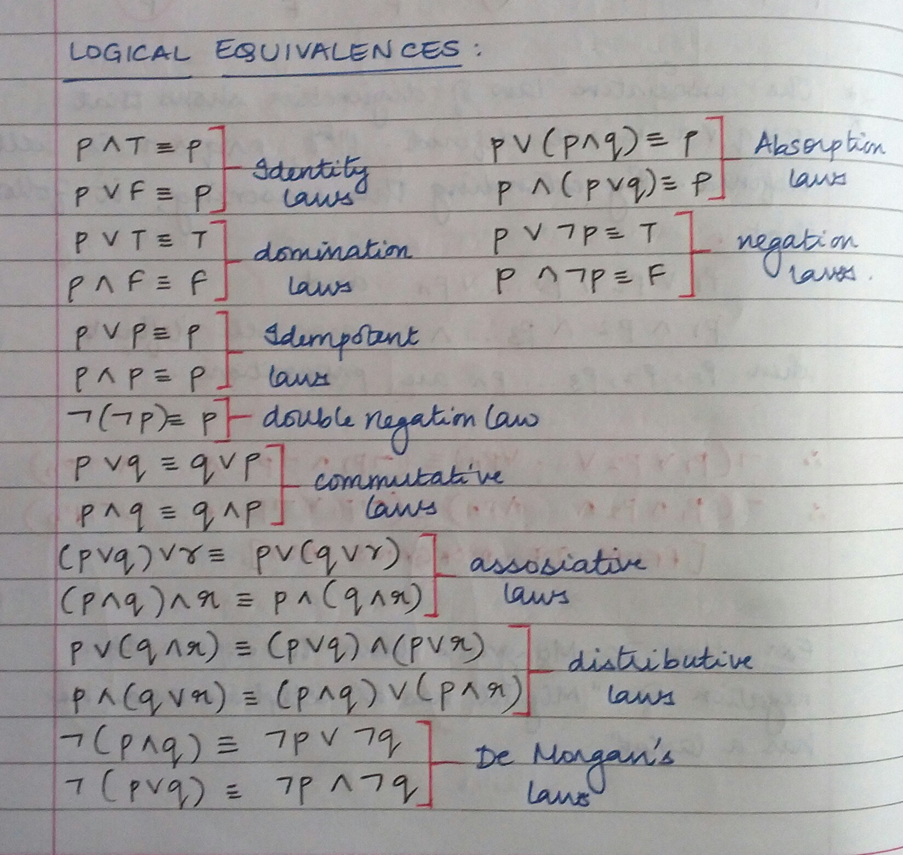

Slide 59
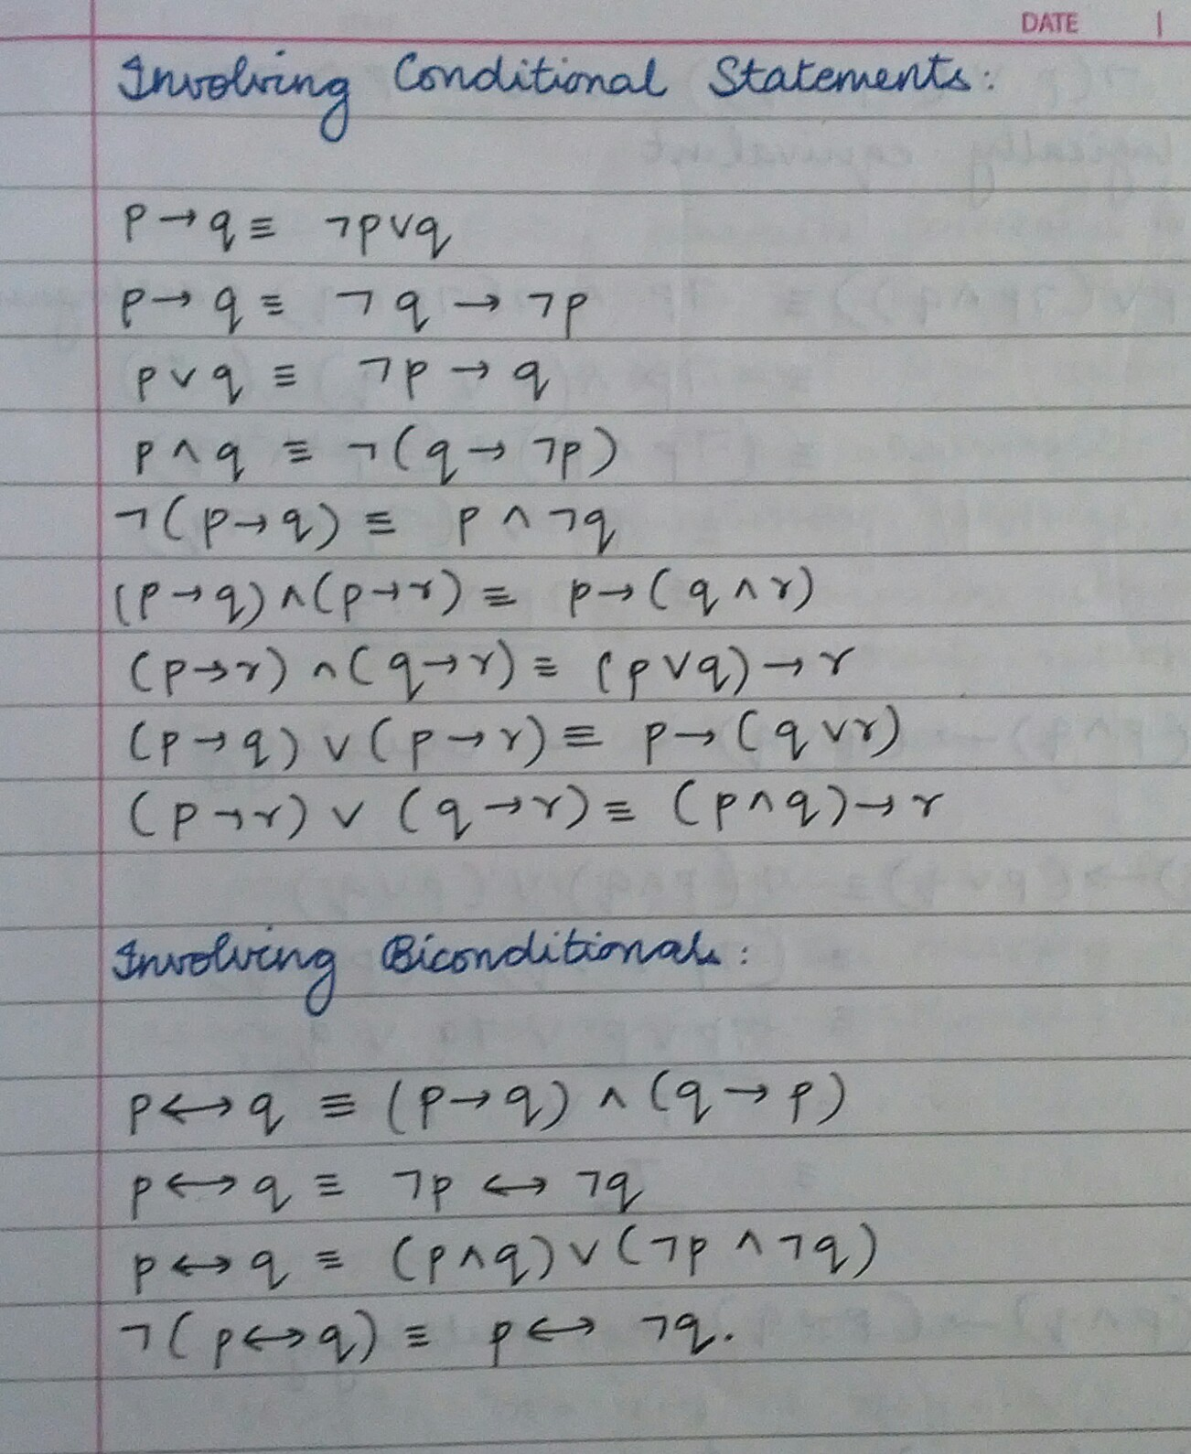

Slide 60
Q: Prove the following logical equivalences using the laws of logic (without using the truth table).
￢(p → q) ≡ p ∧ ￢q
Soln: LHS ≡ ￢(p → q)
≡

Slide 61
Q: Prove the following logical equivalences using the laws of logic (without using the truth table).
￢(p → q) ≡ p ∧ ￢q
Soln: LHS ≡ ￢(p → q)
≡ ￢(￢p ∨ q) ∵ (p → q) ≡￢p ∨ q
≡ ￢(￢p) ∧ ￢q De Morgan’s law
≡ p ∧ ￢q Double negation
∴ ￢(p → q) ≡ p ∧ ￢q

Slide 62
p ∧ (p → q)) ≡ p ∧ q
Soln: LHS ≡ p ∧ (p → q))
≡

Slide 63
p ∧ (p → q)) ≡ p ∧ q
Soln: LHS ≡ p ∧ (p → q))
≡ p ∧ (￢p ∨ q)) ∵ (p→q) ≡(￢p∨q)
≡ (p ∧ ￢p) ∨ (p ∧ q) Distribution law
≡ F ∨ (p ∧ q) Negation law
≡ p ∧ q Identity law
∴ p ∧ (p → q)) ≡ p ∧ q

Slide 64
￢(p ∨ (￢p ∧ q)) ≡ ￢(p ∨ q)
Soln: LHS ≡ ￢(p ∨ (￢p ∧ q))
≡

Slide 65
￢(p ∨ (￢p ∧ q)) ≡ ￢(p ∨ q)
Soln: LHS ≡ ￢(p ∨ (￢p ∧ q))
≡ ￢p ∧ ￢(￢p ∧ q)) De Morgan’s law
≡ ￢p ∧ (￢(￢p) ∨ (￢q)) De Morgan’s law
≡ ￢p ∧ (p ∨ ￢q) Double negation
≡ (￢p ∧ p) ∨ (￢p ∧ ￢q) Distribution law
≡ F ∨ (￢p ∧ ￢q) Negation law
≡ ￢p ∧ ￢q Identity law
≡ ￢(p ∨ q) De Morgan’s law
∴ ￢(p ∨ (￢p ∧ q)) ≡ ￢(p ∨ q)

Slide 66
Q: Prove the following expressions are tautologies using the laws of logic (without using the truth table)
(p ∧ q) → (p ∨ q)
Soln: (p ∧ q) → (p ∨ q)
≡

Slide 67
Q: Prove the following expressions are tautologies using laws of logic (without using truth table)
(p ∧ q) → (p ∨ q)
Soln: (p ∧ q) → (p ∨ q)
≡ ￢(p ∧ q) ∨ (p ∨ q) ∵ (p → q) ≡(￢p ∨ q)
≡ (￢p ∨ ￢q) ∨ (p ∨ q) De Morgan law
≡ ￢p ∨ ￢q ∨ p ∨ q Associative law
≡ ￢p ∨ p ∨ ￢q ∨ q Commutative law
≡ T ∨ T Negation law
≡ T Idempotent law
∴ (p ∧ q) → (p ∨ q) is a tautology

Slide 68
(p ∧ q) → (p → q)
Soln: (p ∧ q) → (p → q)
≡

Slide 69
(p ∧ q) → (p → q)
Soln: (p ∧ q) → (p → q)
≡ ￢(p ∧ q) ∨ (￢p ∨ q) ∵ (p → q) ≡(￢p ∨ q)
≡ (￢p ∨ ￢q) ∨ (￢p ∨ q) De Morgan’s law
≡ ￢p ∨ ￢q ∨ ￢p ∨ q Associative law
≡ ￢p ∨ ￢p ∨ ￢q ∨ q Commutative law
≡ ￢p ∨ ￢q ∨ q Idempotent law
≡ ￢p ∨ T Negation law
≡ T Domination law
∴ (p ∧ q) → (p → q) is a tautology

Slide 70
< End of Logic. Long live logic! />
¬false

